Slide 1

Extending the Distributed Service Profiler
Shelley Lowe
4950257
BTech 451 Project

Slide 2
Project Overview
An existing Distributed Service Profiler is used to display information about the communication (calls) between services
Problems with the current profiler
  Current capabilities of profiler does not include displaying information of calls made by services to the database
  Developers want to know what/where queries are made to help find bottlenecks of the service and improve their code
  Goal of this project is to extend this profiler to integrate the database layer

Slide 3
Profiler - Background Information
Currently displays calls made between services and information of these calls
Information includes method name, time taken to process, argument and return bytes and number of hits
Different services are used to control different things such as a manufacturing service and a core service
The ManufacturingService may need to find a specific job, so will call the MapCoreService with a query findJobByID. This service might then query the database which returns the relevant job

Slide 4
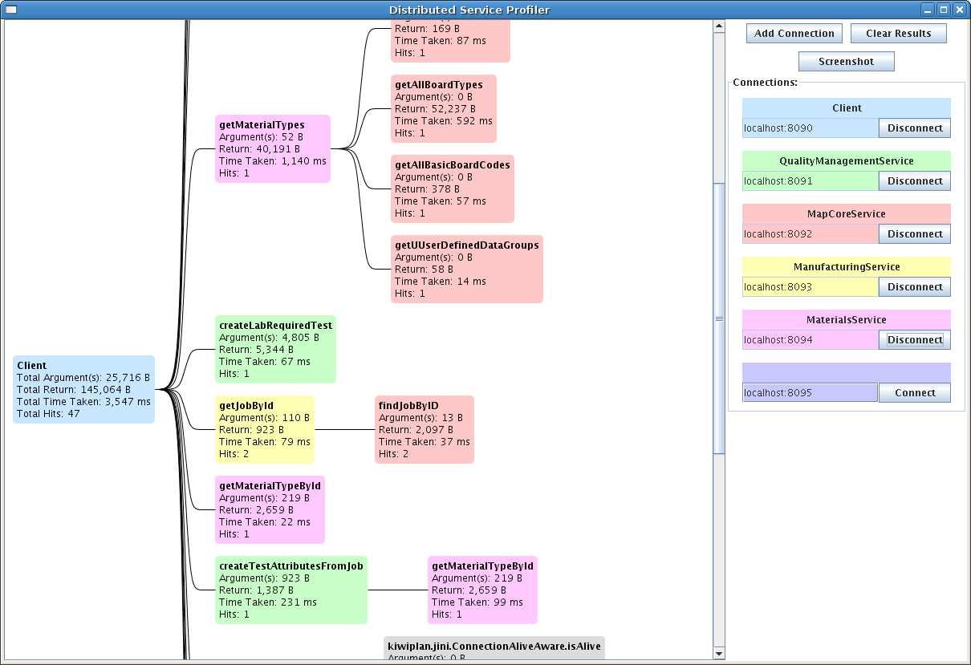
Profiler - Background Information

Slide 5
Earlier Work
Mainly research into methods of intercepting database calls, particularly the Hibernate Interceptor
Brief look into the code for the service profiler to get an idea of how it works
Some research into other topics such as HQL, logging, mbeans etc

Slide 6
Work Since Last Seminar
Mock-up of extended profiler
Implemented a simple Hibernate Interceptor – independent of current profiler, easier for testing
Implemented the LoggerInterceptor and LoggerManager classes for the service profiler
Looking into source code of Service Profiler and DBChangesLogger
Currently creating a PersistenceWrapper class

Slide 7
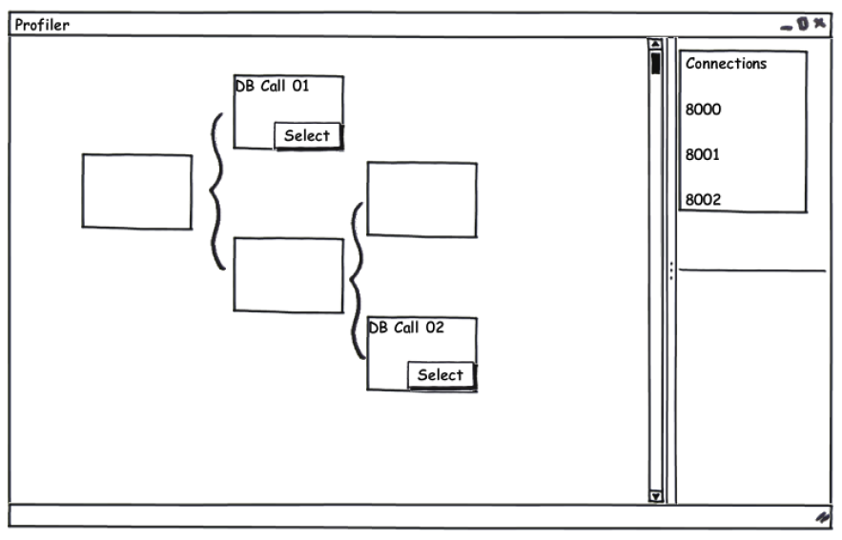
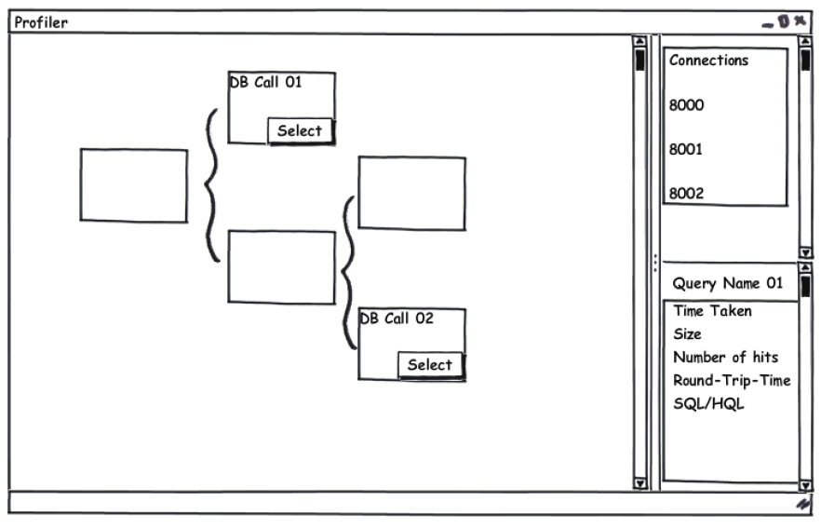
Mock-Up of Extended Profiler
Created using
Balsamiq Mockups

Slide 8
Proposed Solution
Configures Hibernate, SessionFactory, Sessions, Transactions, etc
Profiler
PersistenceWrapper
Creates LoggerInterceptor
LoggerManager
Intercepts DB queries, information will be stored to build up method call tree
LoggerInterceptor

Slide 9
Hibernate Interceptor
An interface in Hibernate which can be used in applications to react to certain events
Can be configured with an application and a database to intercept calls made to that database by the application
Will automatically be invoked every time a insert, delete etc query is made
Can create a class which extends the EmptyInterceptor class and only implement necessary methods

Slide 10
EmptyInterceptor
Interface which is part of the org.hibernate package
Is typically used by developers to extend to create a customized interceptor as only the neccessary methods are implemented
Methods I used - onSave(), onDelete(), onLoad(), onFlushDirty(), afterTransactionBegin() and afterTransactionCompletion()

Slide 11
Demo - Simple Interceptor
Quick demo of how Hibernate Interceptor works
Works with a Contact class (table), runs insert, delete and update queries
Simply prints to console information about the Contact being saved/deleted/updated and the total transaction time

Slide 12
Demo

Slide 13
LoggerInterceptor Class
Basically has the same format as the Simple Interceptor
Needs an associated connection index. This will be used to build up the method call tree which can then be displayed on screen
Intercepted queries will be associated with that index and displayed appropriately in the call tree

Slide 14
LoggerManager Class
Used to create the LoggerInterceptor
Has a method getInterceptor() which creates and returns a LoggerInterceptor using the given connection index

Slide 15
PersistenceWrapper Class
Used to create the LoggerManager, requires the database name, configuration and connection index
Can be used to add Hibernate mapping schemas, build SessionFactorys from a Configuration, create Sessions based on a given SessionFactory and start Transactions using a given Session

Slide 16
What Next
Finishing the PersistenceWrapper class
Integrating the LoggerInterceptor, LoggerManager and PersistenceWrapper classes with the existing profiler
Service profiler will need to create a PersistenceWrapper, and the configurations and sessions for the database will be configured in this class
Storing the intercepted data in a way that the profiler can use to display as part of the method call tree

Slide 17
Questions??

